Slide 1

Take Me Home
Predicting Adoption Wait Times in Animal Shelters Using Machine Learning
Hsien-Hsin Sean Lee · Lindsay Yu
MIT 15.727 Analytical Edge · Spring 2026

Slide 2
PROBLEM & MOTIVATION
The Challenge Facing Animal Shelters
The Problem
6.5M+
Shelters operate under severe resource constraints
Allocation decisions — behavioral training, medical care, marketing — are made from intuition, not data
Poor decisions = longer stays, more stress, lower adoptability
For animals at risk: every day in a shelter matters
animals enter US shelters each year
Our Solution
Predict adoption wait time at intake — before any assessment — to enable immediate, data-driven triage.
MIT 15.727 Analytical Edge · Take Me Home · 2026

Slide 3
DATA
Austin Animal Center (ACC) Shelter Outcomes
Dataset
16 Engineered Features
Source
Austin Animal Center (public)
🐾 Animal
Age, age bucket, sex, neuter status, color, is_named
Focus
Dogs (separate cat model)
🐕 Breed
Target-encoded breed, is_large_breed, is_bully_breed
Outcome
Confirmed adoptions only
🏠 Intake
Intake type & condition (target-encoded)
LOS cap
365 days (outlier removal)
📅 Temporal
Intake month, day of week
Target
log(1 + days to adoption)
Split
80 % training / 20 % test
⚠️ Interaction
sick_senior (sick + over 6 yrs old)
MIT 15.727 Analytical Edge · Take Me Home · 2026

Slide 4
METHODS
Analytical Approach
01
02
03
04
XGBoost
Regression Model
SHAP
Interpretability
K-Means
Clustering
Survival
Analysis
Gradient boosted trees on
log-transformed LOS.
600 trees,
max depth=6, LR=0.04.
Per-feature signed attributions that explain every prediction — usable by non-technical staff.
k = 5 (elbow method). Groups dogs into 5 actionable adoption risk profiles at intake.
Kaplan-Meier curves + Cox PH model. Quantifies bully breed gap and hazard ratios.
MIT 15.727 Analytical Edge · Take Me Home · 2026

Slide 5

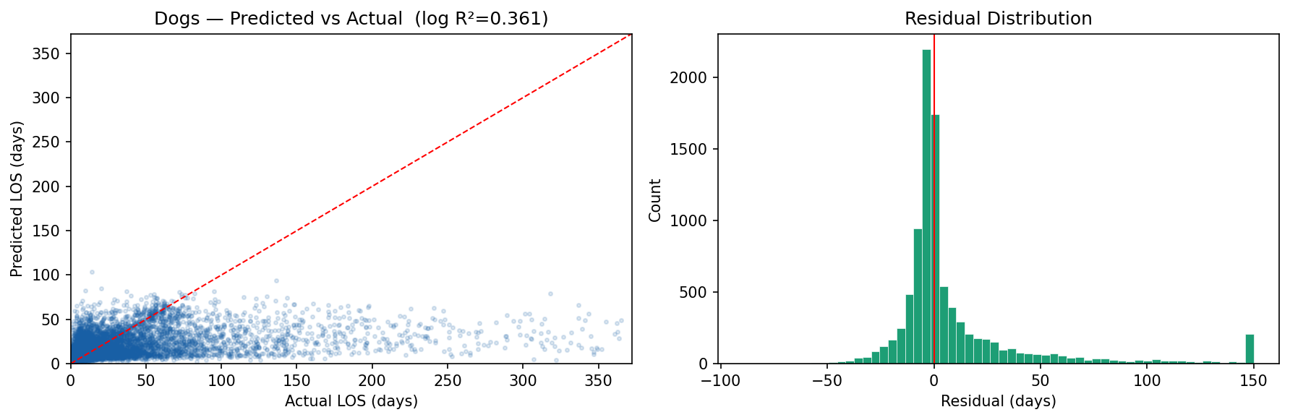
RESULTS for Dogs
Model Performance for Dogs
0.361
19.4
Dog Model
Log-scale R²
Dog Mean Absolute
Error (days)
> 0.30 = reasonably good
typical prediction range
Dogs — Predicted vs. Actual LOS and Residual Distribution
MIT 15.727 Analytical Edge · Take Me Home · 2026

Slide 6

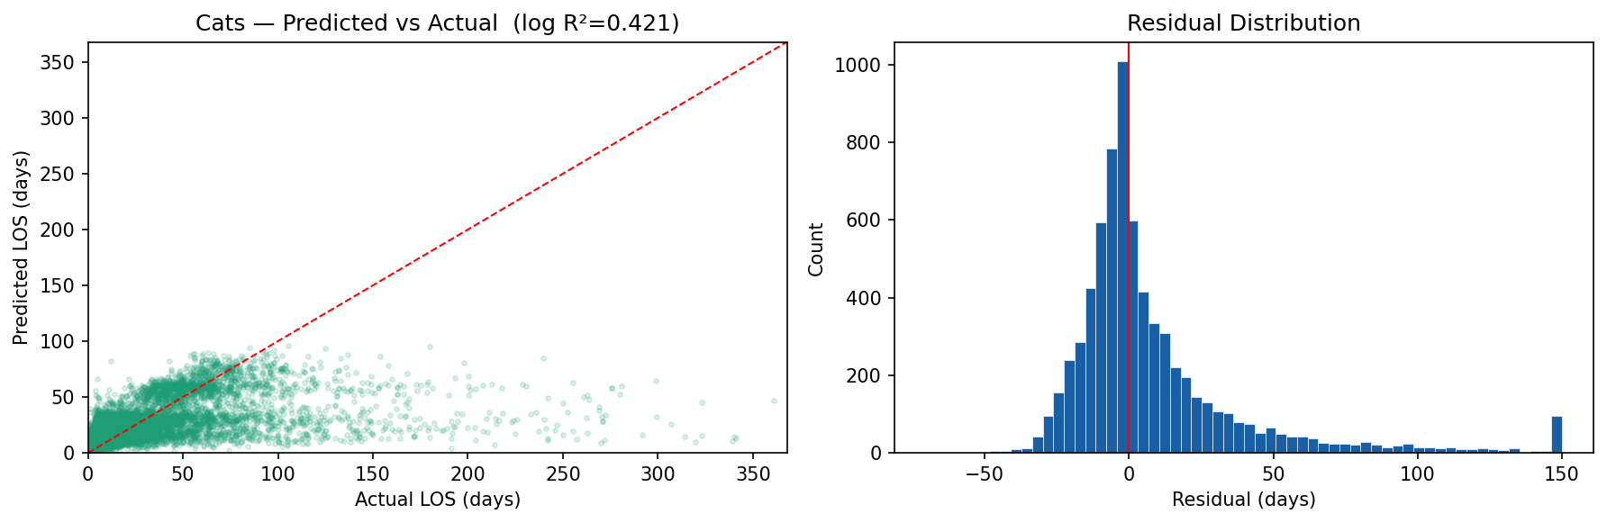
RESULTS for Cats
Model Performance for Cats
0.421
19.6
Cat Model
Log-scale R²
Cat Mean Absolute
Error (days)
cross-species framework
typical prediction range
Cats — Predicted vs. Actual LOS and Residual Distribution
MIT 15.727 Analytical Edge · Take Me Home · 2026

Slide 7
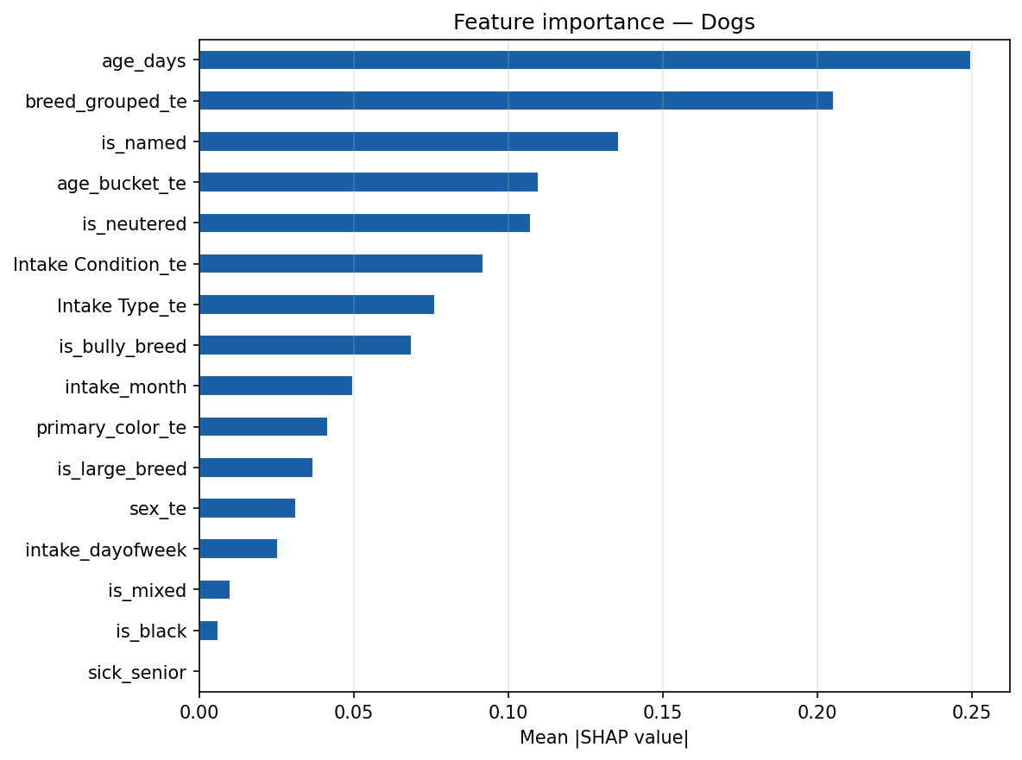
RESULTS for Dogs
What Drives Adoption Speed? (SHAP)
#1
Age
Older dogs wait significantly longer — observable immediately at intake
#2
Breed
Bully breeds + certain mixes face persistent adoption bias
#3
Named
“Named” dogs get adopted faster — a simple, zero-cost intervention
#4
Neutered
Spayed/neutered animals are adopted faster across all breeds
Figure 2. SHAP Feature Importance (Mean |SHAP value|)
** SHAP: Shapley Additive exPlanations
MIT 15.727 Analytical Edge · Take Me Home · 2026

Slide 8
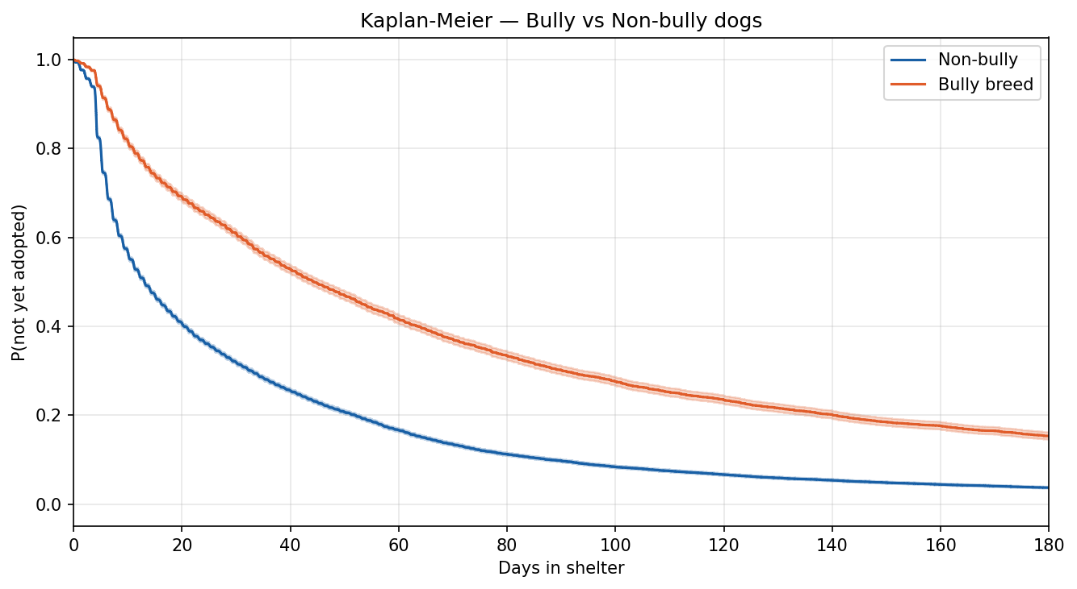
RESULTS for Dogs
The Bully Breed Gap
Key Findings
Day 30
~75% of bully breeds still unadopted vs. ~40% of others
Day 60
Gap persists — bully breeds ~40% still waiting
Day 180
~17% of bully breeds remain vs. ~4% non-bully
Cox PH
Bully breed status significant even after controlling all other factors
Figure 3. Kaplan-Meier — Bully vs. Non-Bully Breed Dogs
MIT 15.727 Analytical Edge · Take Me Home · 2026

Slide 9
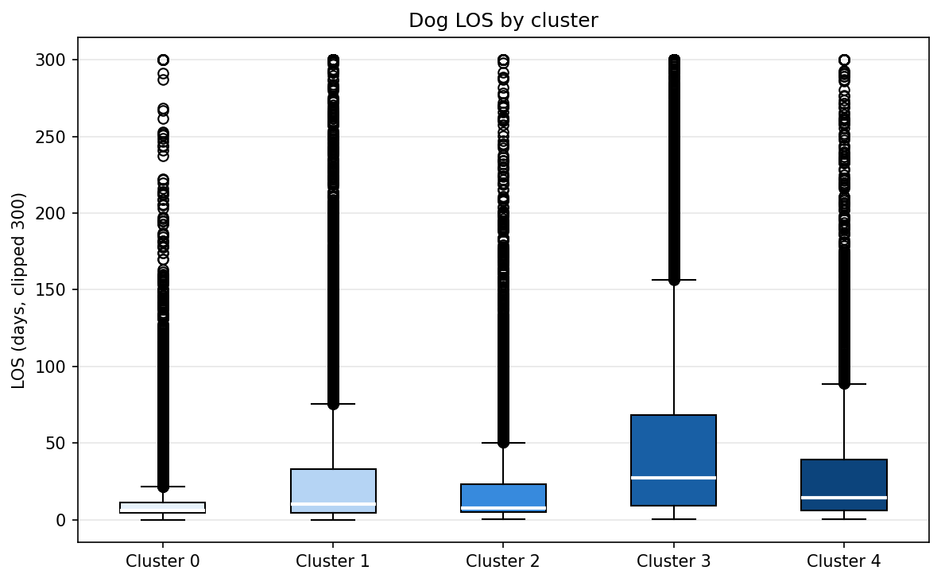
RESULTS for Dogs
5 Dog Adoption Risk Profiles
C0
C1
C2
C3
C4
~8 days
~14 days
~18 days
~32 days
~28 days
median LOS
median LOS
median LOS
median LOS
median LOS
Fast Mover
Moderate
Moderate
High Risk
High Risk
Young, named,
neutered, popular breed
Typical stray,
short-coat, adult
Mixed breed,
normal condition
Older, medical
conditions, unnamed
Bully breed,
owner surrender
Shelters should focus intervention resources on Clusters 3 & 4 from Day 1
MIT 15.727 Analytical Edge · Take Me Home · 2026

Slide 10
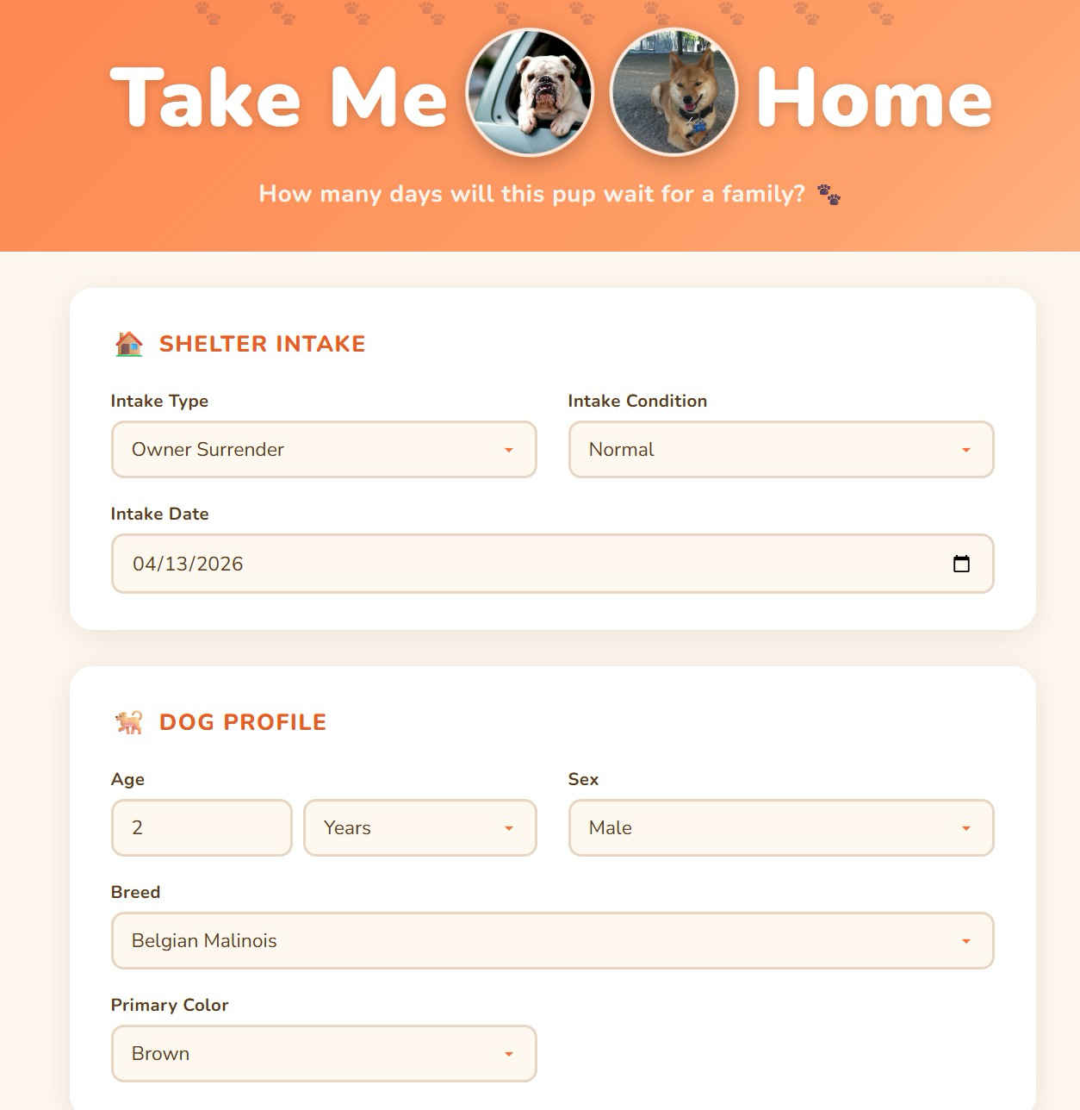
DOGS PLATFORM
Take Me Home — Live Web App
How It Works
1
Staff enters dog attributes at intake
2
XGBoost model runs in the backend
3
App returns predicted wait days + confidence range
4
Shelter flags high-risk animals for immediate action
https://hsienhsinlee.github.io/dogs
MIT 15.727 Analytical Edge · Take Me Home · 2026

Slide 11
DISCUSSION
Limitations & Future Work
Current Limitations
Future Directions
Austin-only data — generalizability untested across cities and shelter policies
Image-based features: photo quality and expression shown to influence online adoption interest
Log-scale R² = 0.361 — behavior at adoption event is unobservable at intake
Multi-shelter generalization: test across diverse geographical locations and policies
Underpredicts very long stays (>100 days) — the highest-stakes cases
Dynamic model: update LOS predictions daily as shelter time accumulates
Naming correlation may reflect reverse causation (staff name those dogs that are likely to be adopted quickly, not causality)
Integration into shelter management systems (PetPoint, Chameleon) for real-time triage
MIT 15.727 Analytical Edge · Take Me Home · 2026

Slide 12
Conclusion & Impact
Data-driven triage from Day 1
01
Age, breed, and name are observable at intake — no behavioral assessment needed to flag risk
02
Naming unnamed animals at intake is a zero-cost, immediately actionable intervention to accelerate adoption
03
Bully breeds need targeted advocacy from Day 1 — the gap is stark and persistent
04
SHAP interpretability makes model recommendations legible to non-technical shelter staff
http://hsienhsinlee.github.io/dogs/ · MIT 15.727 Analytical Edge · Spring 2026

Slide 13
Questions?
Hsien-Hsin Sean Lee · Lindsay Yu
MIT 15.727 Analytical Edge · http://hsienhsinlee.github.io/dogs

